Slide 1
Motion_Controller Evaluation for ‘Misan’ DCSERVO for Arduino
https://github.com/Motion-Controller/dcservo-1

Slide 2
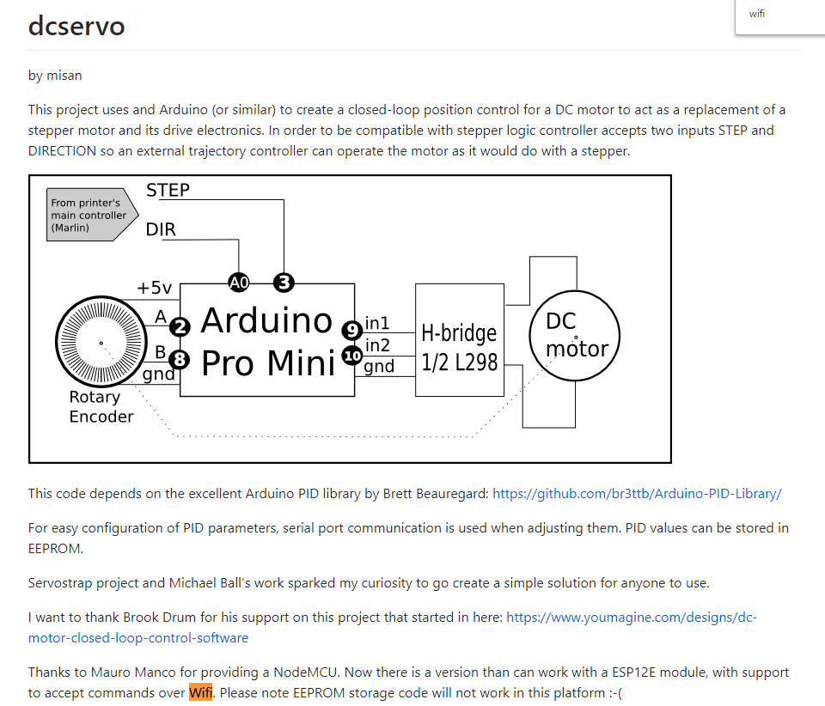
From:
https://github.com/misan/dcservo

Slide 3
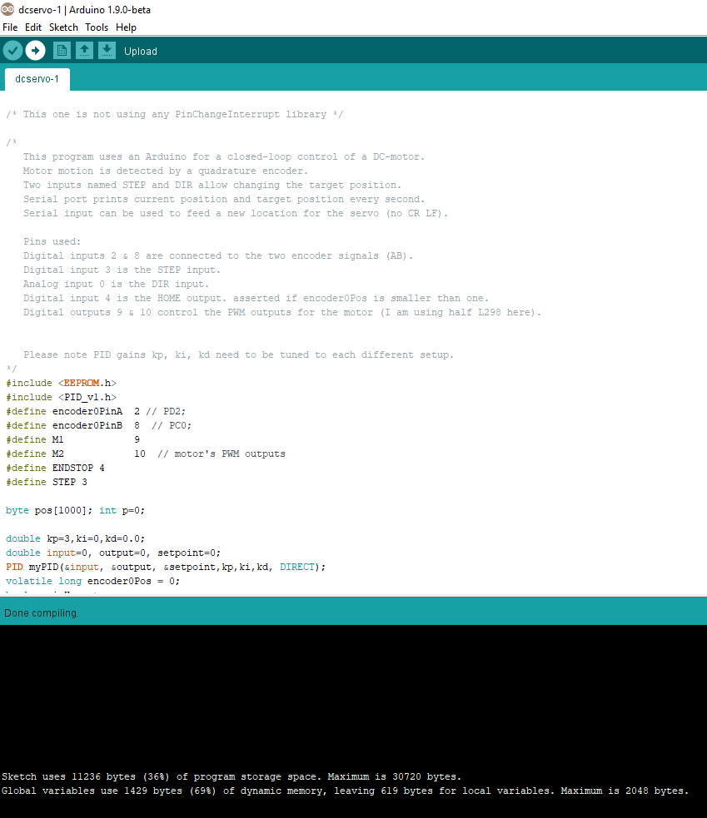


Slide 4
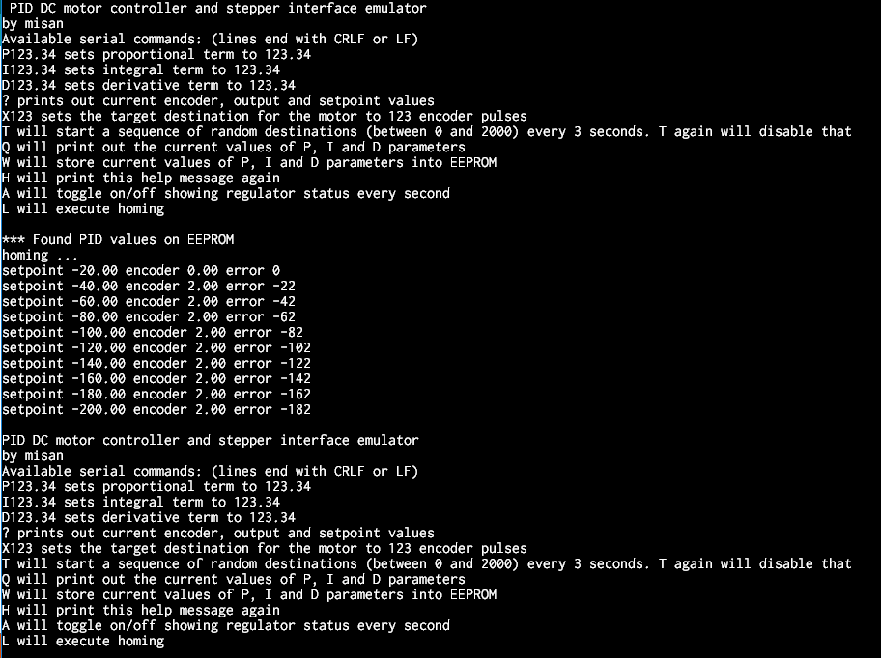

Slide 5
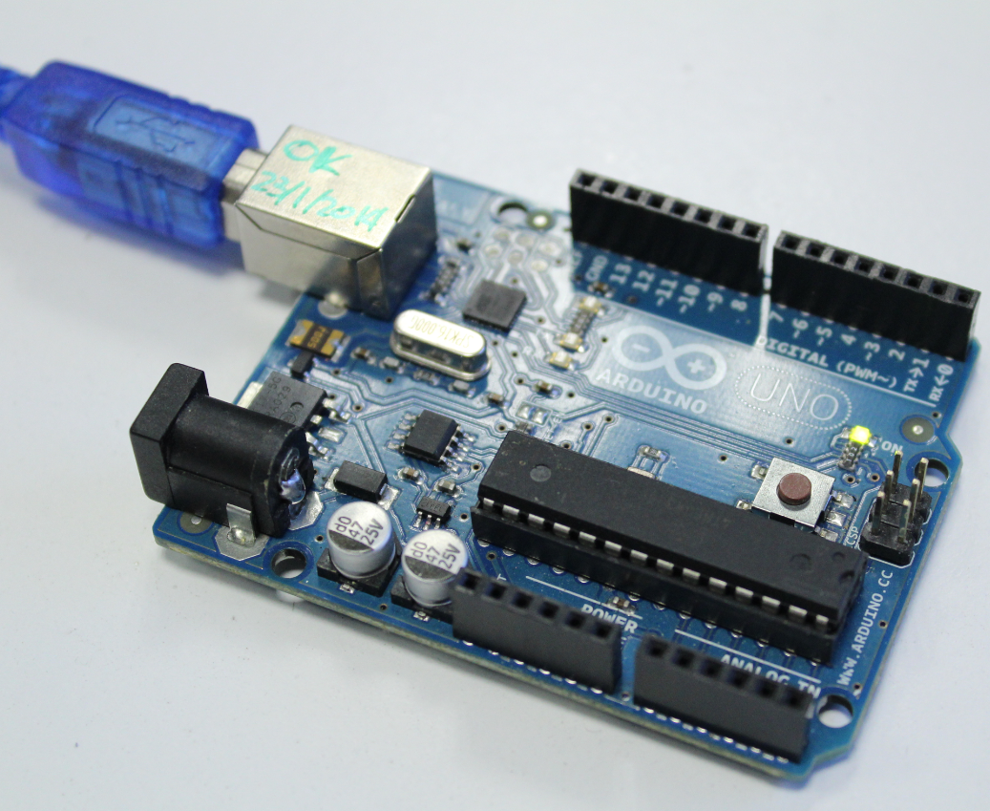

Slide 6
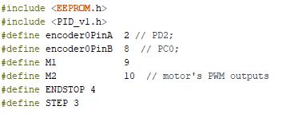

Slide 7
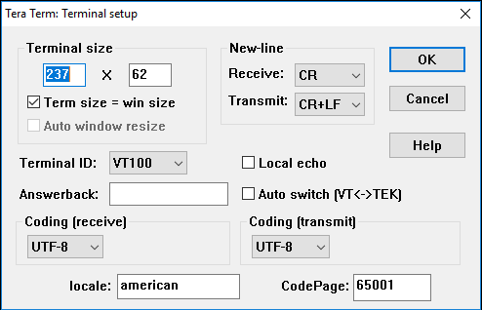
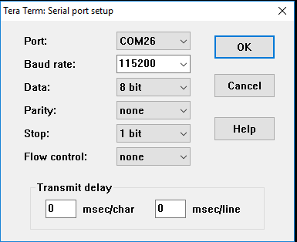

Slide 8
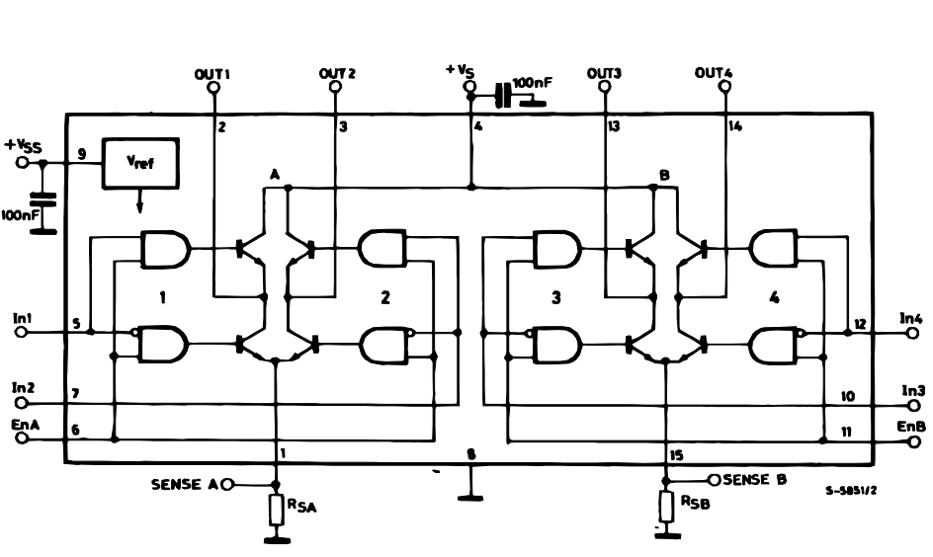
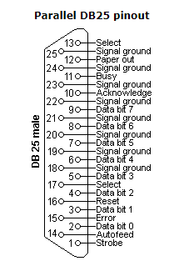
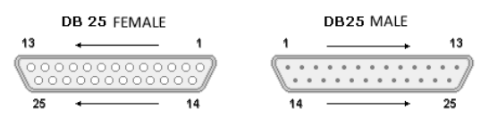

Slide 9
13
25
12
24
11--------------ENC-B
23-----------------------GND
10--------------ENC-A
22-----------------------GND
9
21-----------------------GND
8
20-----------------------GND
7
19-----------------------GND
6
18
5
17
4---------------L298 PIN5 IN1
16
3---------------L298 PIN6 ENABLE
15
2---------------L298 PIN7 IN2
14
1

Slide 10
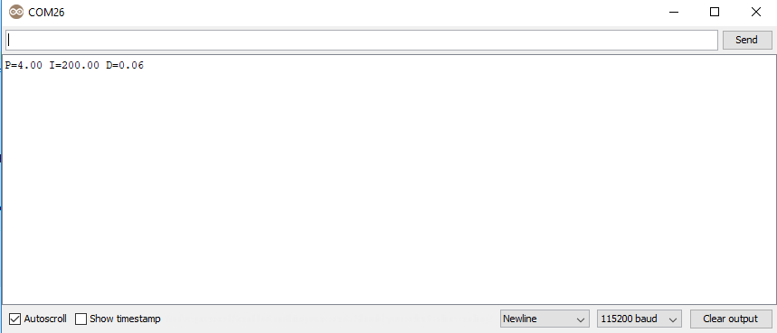
The characters and LF have to be send in a single packet, otherwise
(like when using Teraterm) the firmware is hard to control

Slide 11
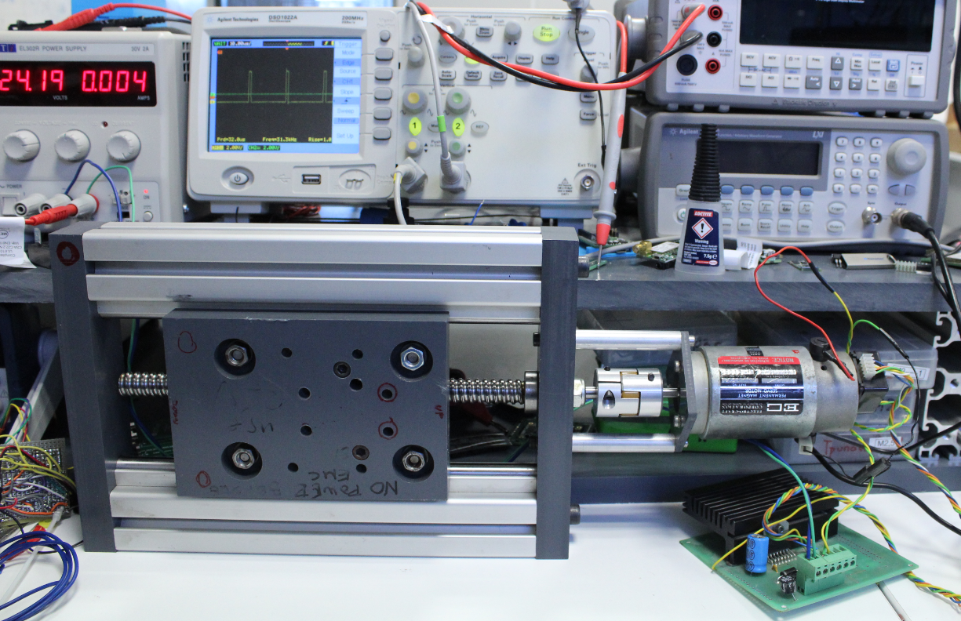

Slide 12
